Slide 1
CSE 691 Final Project
Deep-Q Learning Pong Game
Akshay
Nishant Agrawal
Sushant Garg
Yaser Syed

Slide 2
ReInforcement Learning
Concerned with how Software Agents take actions in an environment to maximize reward
Input/Output pairs are never presented
Agent learns from experience
Trial-and-Error approach is used

Slide 3
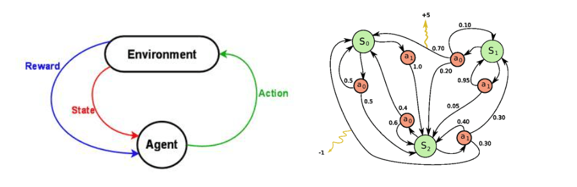
Markov Decision Process
A set of environment & agent states
A set of actions A of the agent
Pa (s, s’) : Probability of transition from state s to s’ under action a
Ra (s, s’) : Immediate reward after transition
Stochastic rules that describe what an agent observes

Slide 4
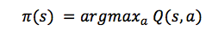
Q function
It represents the quality of an action ‘a’ in a given state ‘s’
Here, π represents the policy, where we maximize the quality, hence getting the best possible score at the end of the game after performing action a in state s
Just like with discounted future rewards, we can express the Q-value of state s and action a in terms of the Q-value of the next state s’.

Slide 5
Q learning
Choose an action a to perform in the current state, s.
Perform a and receive reward R (s, a).
Observe the new state, S (s, a).
Update Q function
If the next state is not terminal, go back to step 1.

Slide 6
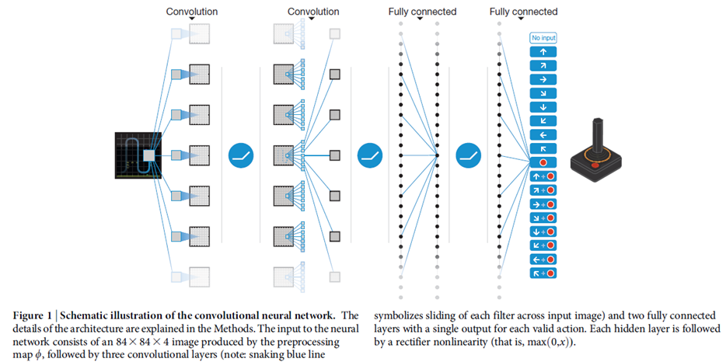
Deep Q-Network

Slide 7
Application
Input: 4 frames of 80*80 normalized grayscale image
Size of Input: 80*80*4=25600; with two states makes it- 2^25600
So we compress it using deep CNN to get 512 floats
Output: 3 possible actions

Slide 8
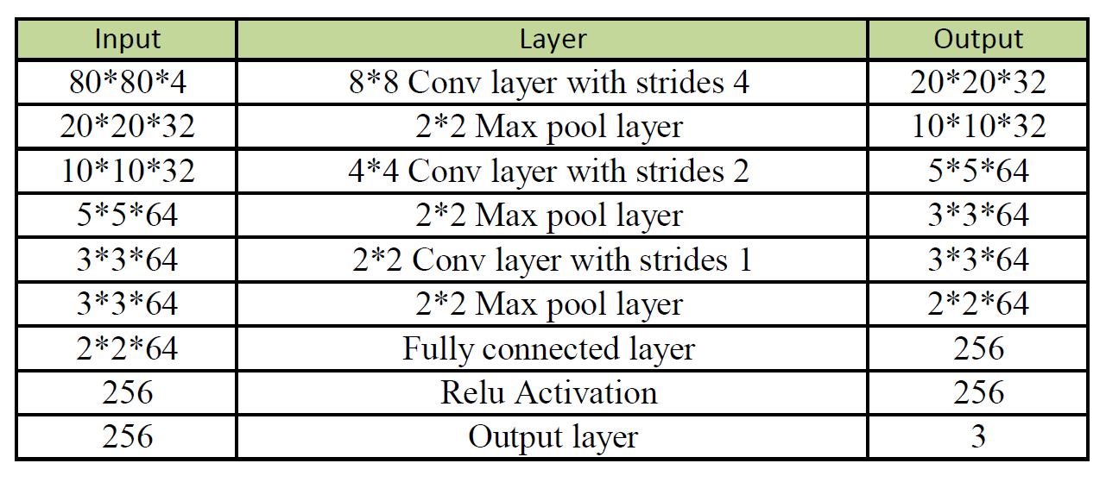
Architecture of Network

Slide 9
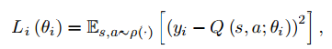
Learning and Testing
Loss Function:
y is the expected reward
loss = tf.reduce_mean(tf.square(output - targets))
Theta = weight and bias
Learning Rate: 1e-6
MINI_BATCH_SIZE = 100
Decay rate = 0.99

Slide 10
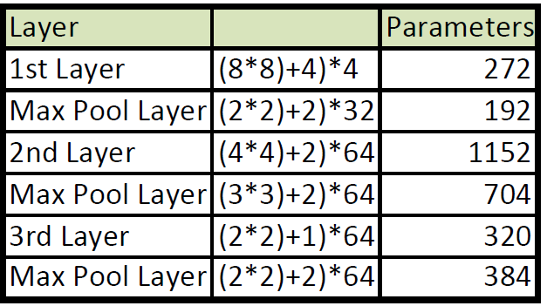
Analysis - Memory Requirement

Slide 11
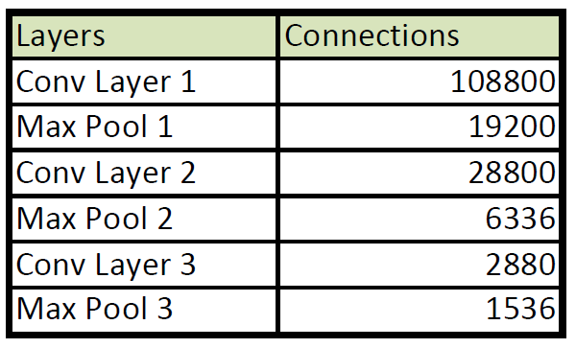
Analysis - Computational Complexity

Slide 12
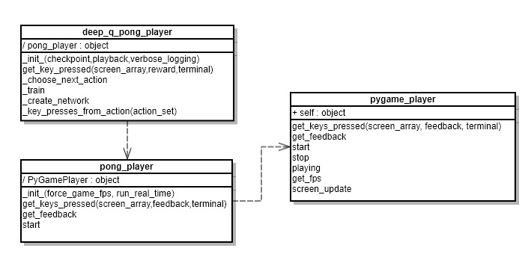
Analysis - Structure of Code

Slide 13
Extension: Flappy bird
Input: Normalized grayscale image re-sized to 80*80, stacked last 4 frames to get input array of size 80*80*4
Output: 2 possible actions - Flap or not flap
HyperParameters:
Discount factor, γ =0.99
Observe timesteps = 100000
Explore timesteps = 200000
Replay memory =50000
Batchsize = 32
Initial epsilon = 0.1
Final epsilon = 0.0001
Frames per sec = 1

Slide 14
Extension: Flappy bird contd.
Network:
6 hidden layers between input and Q layer
Convolution with filter size 8, stride 4
Avg. pool with filter size 2, stride 1
Convolution with filter size 4, stride 2
Convolution with filter size 3, stride 1
2 FC layers with Relu activation
Random minibatch from replay memory used for training
Used Adam optimizer to minimize the cost

Slide 15
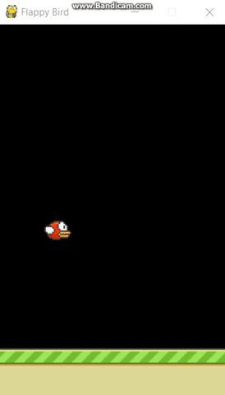
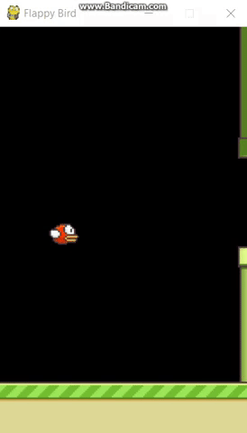
Original source trained for over 3 million timesteps (https://github.com/yenchenlin/DeepLearningFlappyBird)
Our own model trained for over 600k timesteps

Slide 16
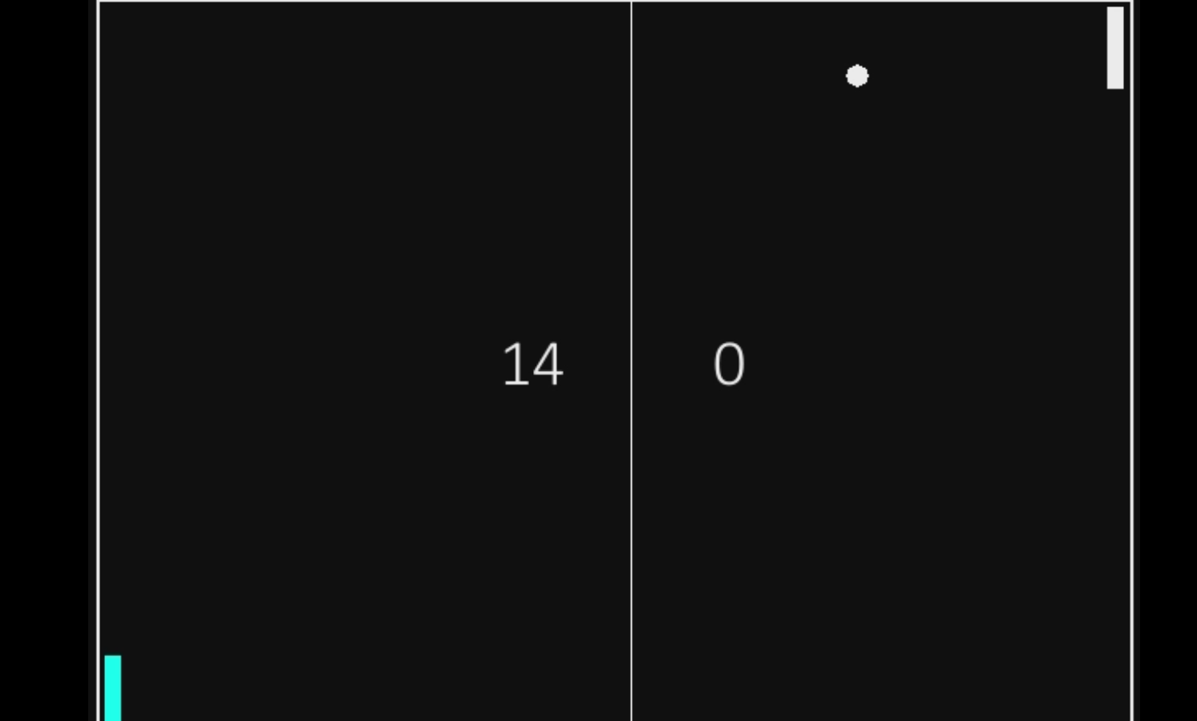
Improvement
Max pooling may have discarded useful information.
Removed last two max pooling layers
Converges Faster
Image below at 700000 th timestep

Slide 17
HyperParameters
Decay rate of past observations (Gamma) =0.99
Timesteps to observe before training = 50000
Number of previous transactions to remember =590000
Batchsize = 32
Initial epsilon =1.0
Final epsilon = 0.04

Slide 18
Innovation
Convolutional Networks take too long to train on a standard pc.
Since pong is a relatively simple game , it should be possible to train it much faster if we make it more domain specific.
We remove the convolutional part of the model and introduce a simple Q network with 2 hidden layers and 1 output layer .
Input:
Position of Paddle
Position of Ball (X,Y)
Direction of Ball (X,Y)

Slide 19
Network Config:
2x Hidden Layers 1x Output Layer
Activation Function for hidden layers : ReLu Activation
Linear Output Layer
Output gives out an action which is to be performed (3 Actions)
Rewards:
Rewards are given for simply touching the ball with the paddle.
A penalty is given which the paddle misses the ball.

Slide 20
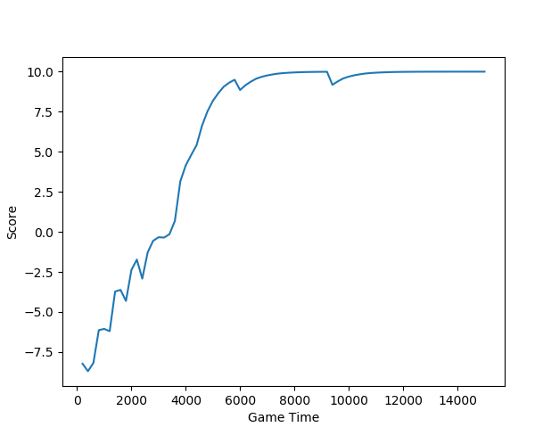
Results:
Extremely fast
Converges even before 10000 timesteps
Cannot be extended to other games

Slide 21
Summary
Understood the basic application requirements and the input/output data format as well
Studied the architecture of Deep Q learning neural network used for this application
Learned and performed testing using loss function, learning rate & a variety of hyper parameters
Analyzed memory requirement, complexity and structure of code
Able to run code successfully & demo the same
Extended the application in the form of a Flappy Bird game
Retrained & Improved the network
Completely removed Convolutional layers and made new Q network

